Slide 1
Cybersecurity Awareness and Resource Guide
Boeing Enterprise Security
For current and potential suppliers
November 2024

Slide 2
Boeing cybersecurity overview
Cybersecurity Awareness and Resource Guide
Boeing Enterprise Security
Effectively managing cybersecurity risks in supply chains requires a comprehensive view of threats and vulnerabilities and ensuring the integrity, security, quality and resilience of the products, services, employees and privileged users.
Suppliers need to be ready and able to protect their data in the event of an attack, while also being prepared to respond and recover should an incident occur. Cybersecurity is a collective responsibility in an organization, and every employee has a role to play.
The Boeing Cybersecurity Awareness and Resource Guide for Existing and Potential Suppliers is intended to provide a high-level overview of the Cyber Supply Chain Risk Management (C-SCRM) best practices.

Slide 3
This guide covers:
Cybersecurity Awareness and Resource Guide
Boeing Enterprise Security
Introduction
Cybersecurity pillars
Boeing supplier expectations and resources
NIST Cybersecurity Framework (CSF) 2.0
Doing business with Boeing – cybersecurity
Boeing supplier quick reference guide

Slide 4
Introduction
Cybersecurity Awareness and Resource Guide
Boeing Enterprise Security
The Boeing Company recognizes that current and potential vendors may have differing cyber maturity levels.
The National Institute of Standards and Technology (NIST) Cybersecurity Framework (CSF) 2.0 provides foundation of the Cybersecurity Awareness and Resource Guide, which helps suppliers assess their cybersecurity practices and track their cybersecurity controls.
These security disciplines should be assessed, and vulnerabilities fixed to improve an organization's security:
Network security
Endpoint security
Data security
Access management
Application security
Physical security
Incident response and disaster recovery plan
Security awareness training
Third-party risk management
Compliance and policy management
Disclaimer: The Boeing Cybersecurity Awareness and Resource Guide is intended to provide awareness and resources to better manage cybersecurity risks. Use of this Guide DOES NOT serve as evidence for certification or compliance for your organization with respect to applicable jurisdiction statutes and regulations.

Slide 5
Cybersecurity pillars
Cybersecurity Awareness and Resource Guide
Boeing Enterprise Security
Confidentiality, ensuring information is only available to, or shared with authorized individuals.
Integrity, ensuring information protection against unauthorized modification or destruction.
CONFIDENTIALITY
Availability, ensuring timely and reliable access to, and use of information.
Authenticity, ensuring systems are in place to verify users interacting with the data are who they say they are. Examples include biometrics, multi-factor authentication (MFA) and security tokens.
INTEGRITY
Non-Repudiation, ensuring systematic checks that someone cannot falsely deny that they created, altered, observed or transmitted protected data.
AVAILABILITY

Slide 6
Boeing supplier expectations and resources
Cybersecurity Awareness and Resource Guide
Boeing Enterprise Security
To safeguard the company’s commercial and defense-related businesses and support its production operations, The Boeing Company has adopted security principles in accordance with the NIST Cybersecurity Framework (CSF) 2.0 and NIST 800-171 requirements detailed in the common Cybersecurity Compliance and Risk Assessment (CCRA) for the Defense Industrial Base. Boeing expects similar efforts from suppliers to adequately protect their supply chain.
Boeing does not require suppliers to be certified under any specific framework. The expectation is all suppliers will adopt security practices in accordance with industry-leading security frameworks such as ISO 27001 or CSF 2.0.
In addition to collaborating with existing and potential suppliers to ensure a robust cybersecurity posture, The Boeing Company collaborates with its internal stakeholders throughout the enterprise to clearly establish responsibilities and capabilities to best manage cybersecurity risk associated with its products, services, employees and privileged users. Suppliers may review the Terms of Use and Cybersecurity Supplement to preview Boeing’s contractual cybersecurity expectations.

Slide 7
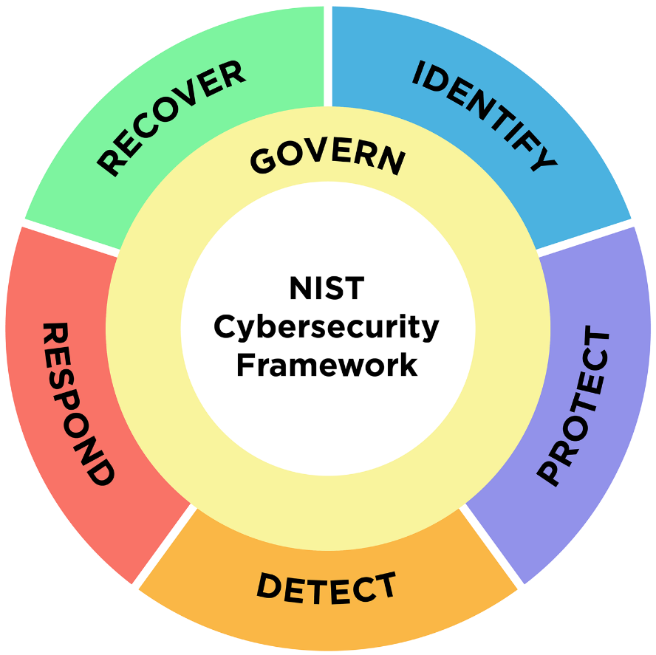
NIST Cybersecurity Framework (CSF) 2.0
Cybersecurity Awareness and Resource Guide
Boeing Enterprise Security
The six CSF 2.0 functions, as defined below, are not intended to form a serial path or lead to a static desired end state. These functions should be performed concurrently to form an operational culture that addresses the dynamic cyber risks.
1 | Govern
2 | Identify
Develop, monitor and communicate a cybersecurity risk management strategy outlining expectations and policy.
Develop an organizational understanding to manage cybersecurity risks to systems, people, assets, data and capabilities.
6 | Recover
3 | Protect
Develop and implement appropriate activities to maintain plans for resilience and to restore any capabilities or services that were impaired due to a cybersecurity incident.
Develop and implement appropriate safeguards to ensure delivery of critical services.
5 | Respond
Develop and implement appropriate activities to act regarding a detected cybersecurity incident.
4 | Detect
Develop and implement appropriate activities to identify the occurrence of a cybersecurity event.
Courtesy nist.gov

Slide 8
Govern
Cybersecurity Awareness and Resource Guide
Boeing Enterprise Security
The Govern Function assures an organization’s expectations and policies are shared and establishes a cybersecurity risk management strategy.
Develop, monitor and communicate a cybersecurity risk management strategy outlining expectations and policy.
Outcome Categories: Information Security Policy, Business Environment, Governance, Risk Assessment and Risk Management Strategy.

Slide 9
Identify
Cybersecurity Awareness and Resource Guide
Boeing Enterprise Security
The activities in the Identify Function ensures understanding of the business context, the resources that support critical functions and the related cybersecurity, which enables an organization to focus and prioritize its efforts consistent with its risk management strategy and business needs.
Develop an organizational understanding to manage cybersecurity risks to systems, people, assets, data and capabilities.
Outcome Categories: Asset Management, Vulnerability Management, Data Tracking and Business Environment.

Slide 10
Protect
Cybersecurity Awareness and Resource Guide
Boeing Enterprise Security
The Protect Function supports the ability to limit or contain the impact of a potential cybersecurity event.
Develop and implement appropriate safeguards to ensure delivery of critical services.
Outcome Categories: Identity Management and Access Control, Awareness and Training, Data Security, Information Protection Processes and Procedures, Maintenance and Protective Technology.

Slide 11
Detect
Cybersecurity Awareness and Resource Guide
Boeing Enterprise Security
The Detect Function enables timely discovery of cybersecurity events.
Develop and implement appropriate activities to identify the occurrence of a cybersecurity event.
Outcome Categories: Anomalies and Events, Security Continuous Monitoring and Detection Processes.

Slide 12
Respond
Cybersecurity Awareness and Resource Guide
Boeing Enterprise Security
The Respond Function supports the ability to contain the impact of a potential cybersecurity incident.
Develop and implement appropriate activities to act regarding a detected cybersecurity incident.
Outcome Categories: Response Planning, Communications, Analysis, Mitigation, and Improvements.

Slide 13
Recover
Cybersecurity Awareness and Resource Guide
Boeing Enterprise Security
The Recover Function supports timely recovery to normal operations to reduce the impact from a cybersecurity incident.
Develop and implement appropriate activities to maintain plans for resilience and to restore any capabilities or services that were impaired due to a cybersecurity incident.
Outcome Categories: Recovery Planning, Improvements, and Communications.

Slide 14
Doing business with Boeing – cybersecurity
Cybersecurity Awareness and Resource Guide
Boeing Enterprise Security
Boeing collaborates with its suppliers to clearly establish responsibilities and capabilities to best manage cybersecurity risk associated with the products or services provided.
To better understand the cybersecurity posture of our suppliers, Boeing has established a cybersecurity questionnaire to measure a supplier’s cybersecurity maturity through Exostar’s Partner Information Manager (PIM) portal.
In the event where incident reporting is needed, please email Abuse@boeing.com.

Slide 15
Boeing supplier quick reference guide
Cybersecurity Awareness and Resource Guide
Boeing Enterprise Security
Cybersecurity & Infrastructure Security Agency’s (CISA) National Cyber Awareness System (including Cyber Tips, Incidents and Vulnerabilities)
Protecting Controlled Unclassified Information in Nonfederal Systems and Organizations (NIST SP 800-171)
Office of the Secretary of Defense FAQs for DFARS 252.204-7012
Aerospace Industries Association Resources
Exostar Cybersecurity Resources
Supply Chain Risk Management Practices for Federal Information Systems and Organizations – NIST 800-161
NIST Framework

